Slide 1



NAME OF WORKS : CONSTRUCTION OF STORM WATER DRAINAGE AND UNDER GROUND SEWERAGE FOR CHHAPRA ROAD FOR NAVSARI
–VIJALPORE NAGARPALIKA, NAVSARI.
Sthapati Designers & Consultants Pvt. Ltd.
“Ohm Chamber” Station Road, Navsari- 396445, Gujarat.

Slide 2
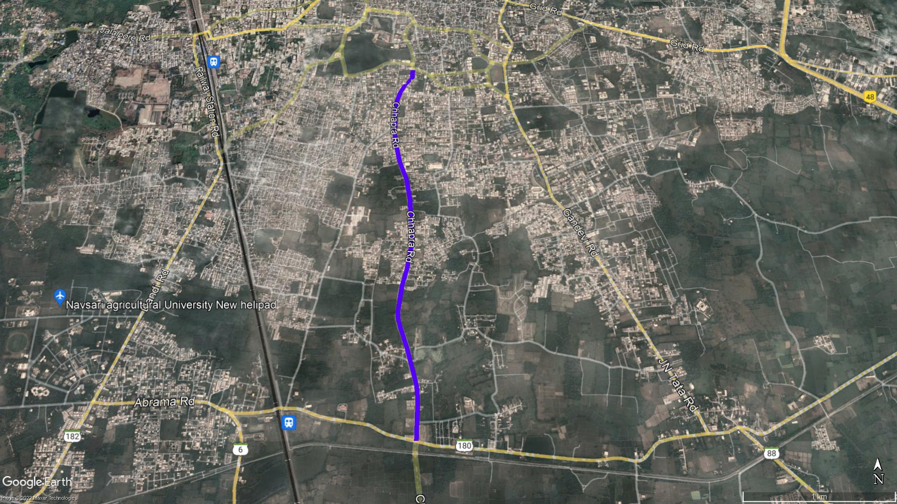
Site Location
Technical School
Chhapra Road
Chhapra Road
Chhapra Road
Gandhi Smruti Road

Slide 3
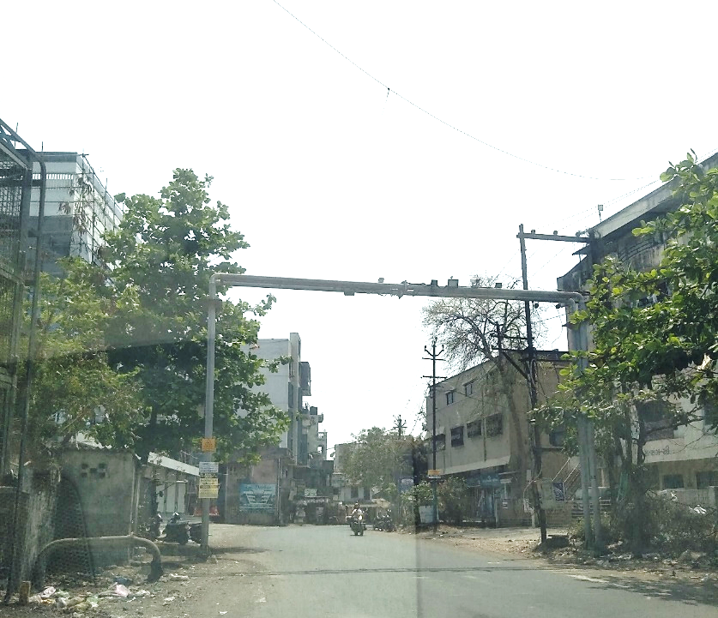
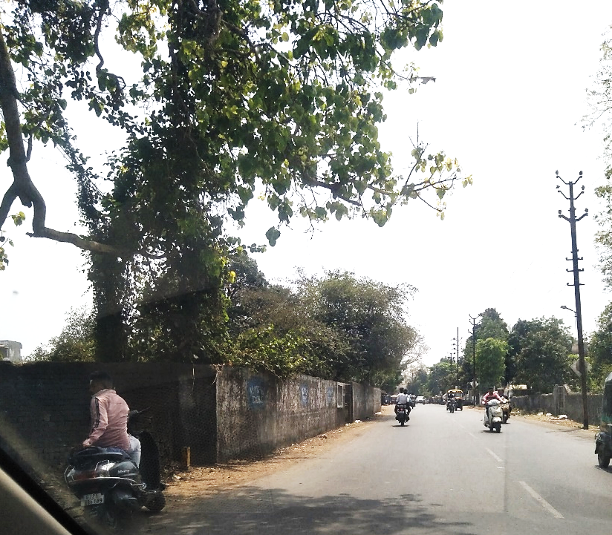
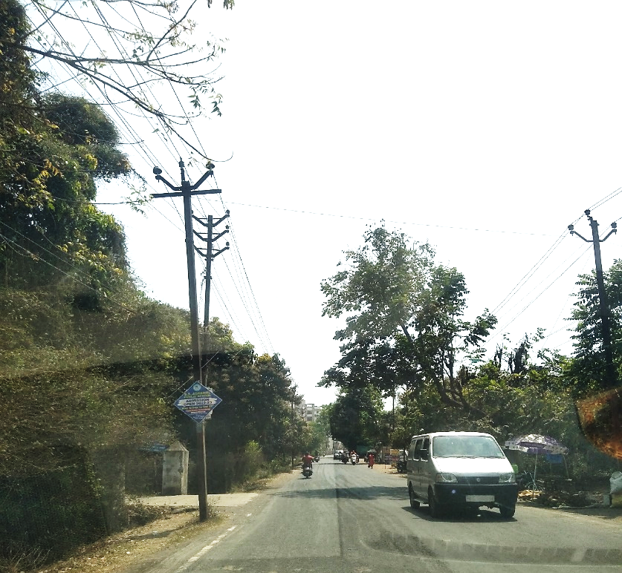
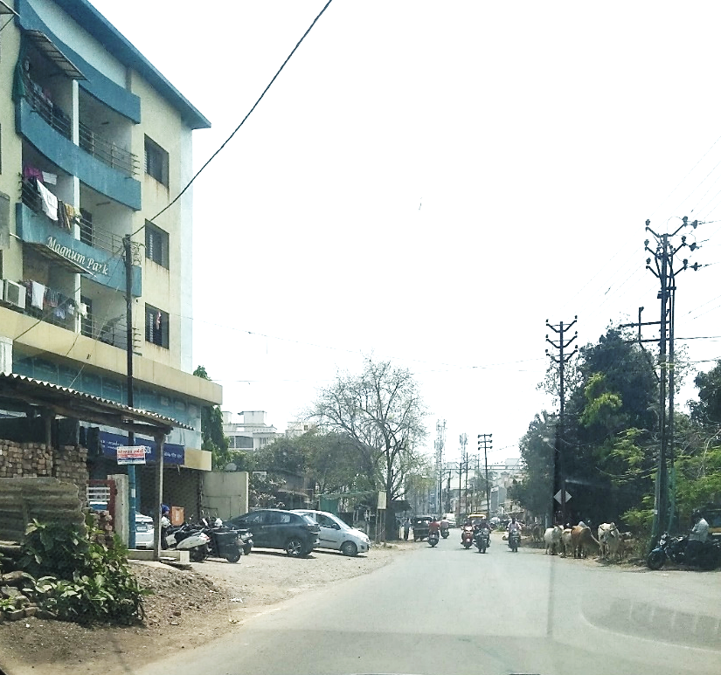
Existing Site Photos

Slide 4
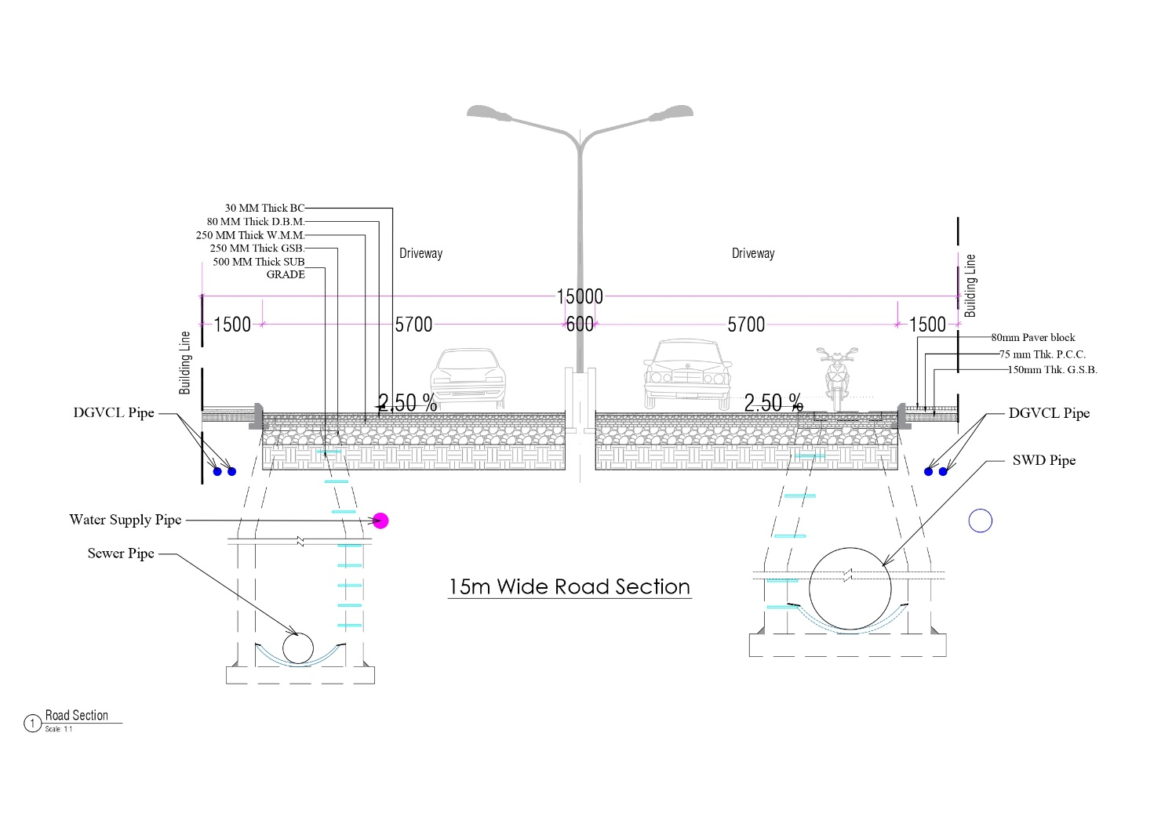
ROAD SECTION-15 m wide road

Slide 5
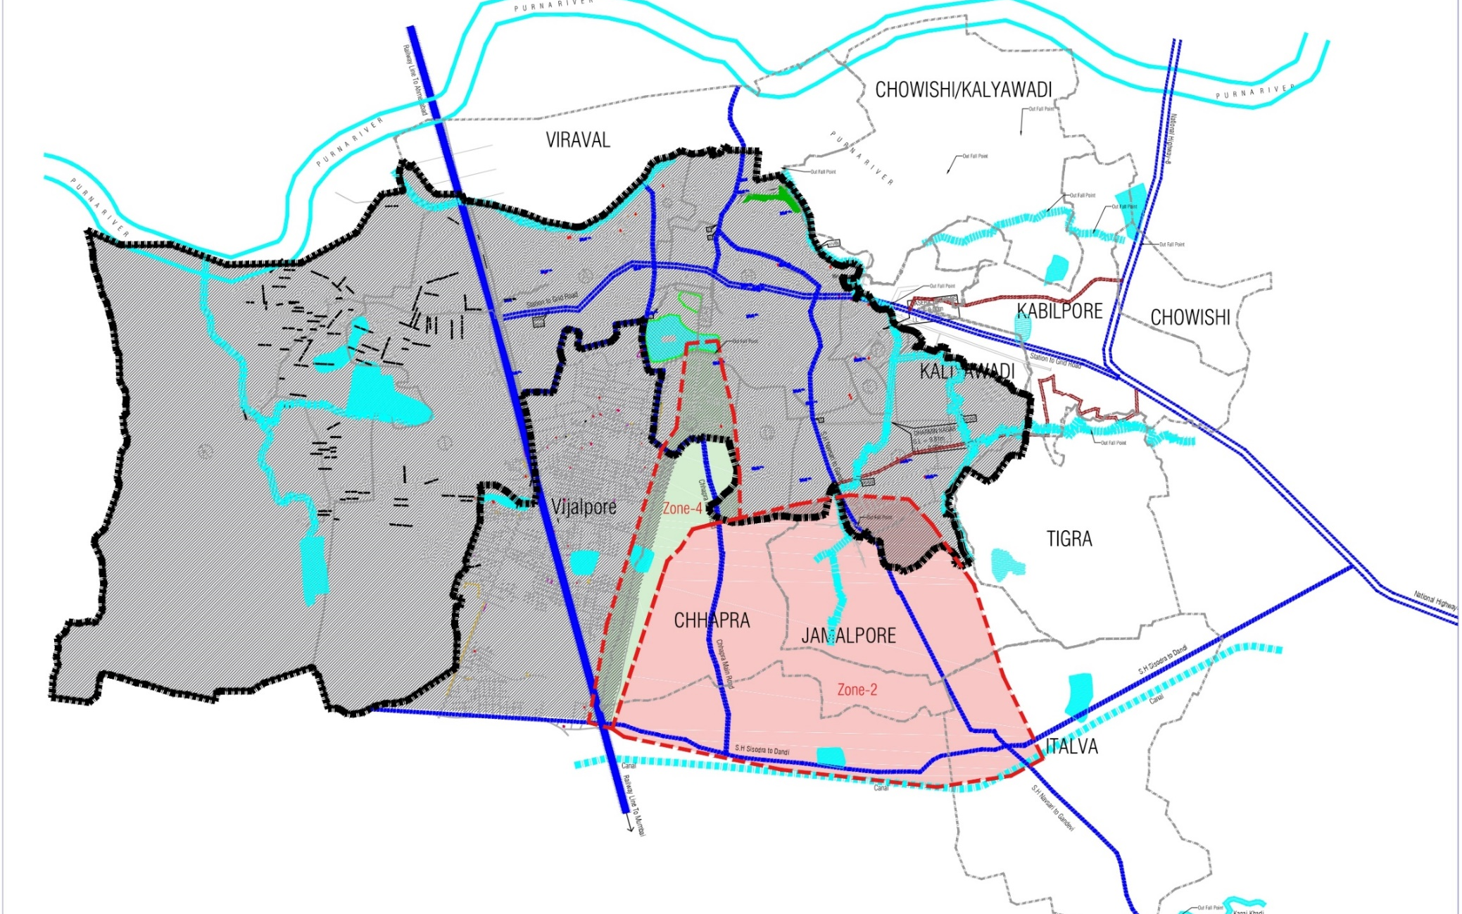
Storm Water Drain
Contributing Road

Slide 6
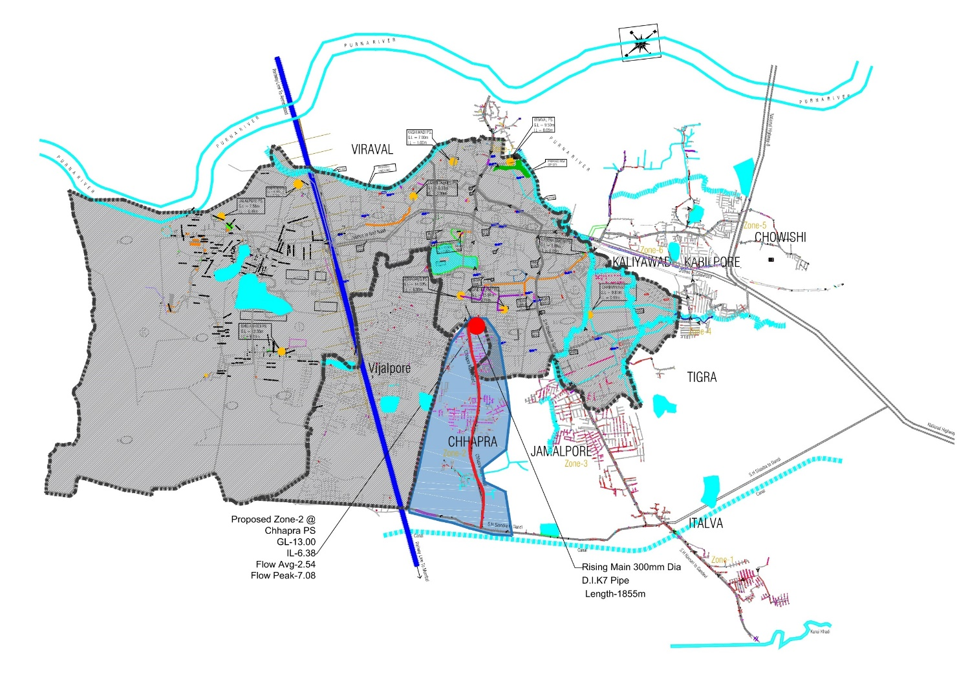
Sewer Road Network
Contributing Road

Slide 7
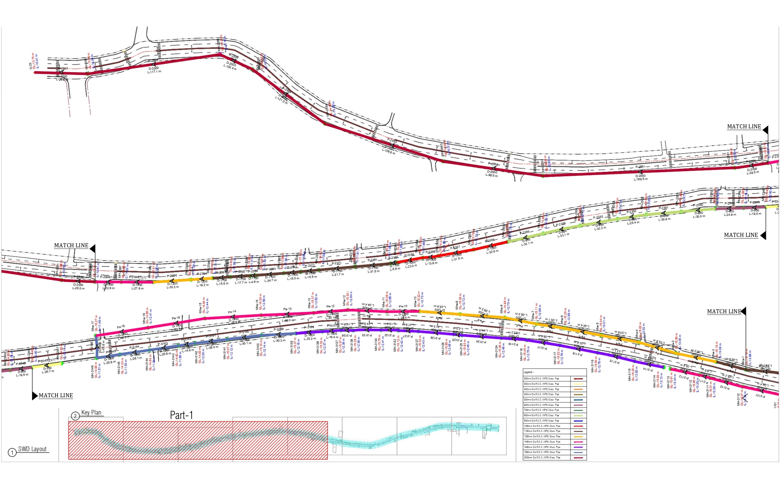
Storm Water Drain Layout

Slide 8
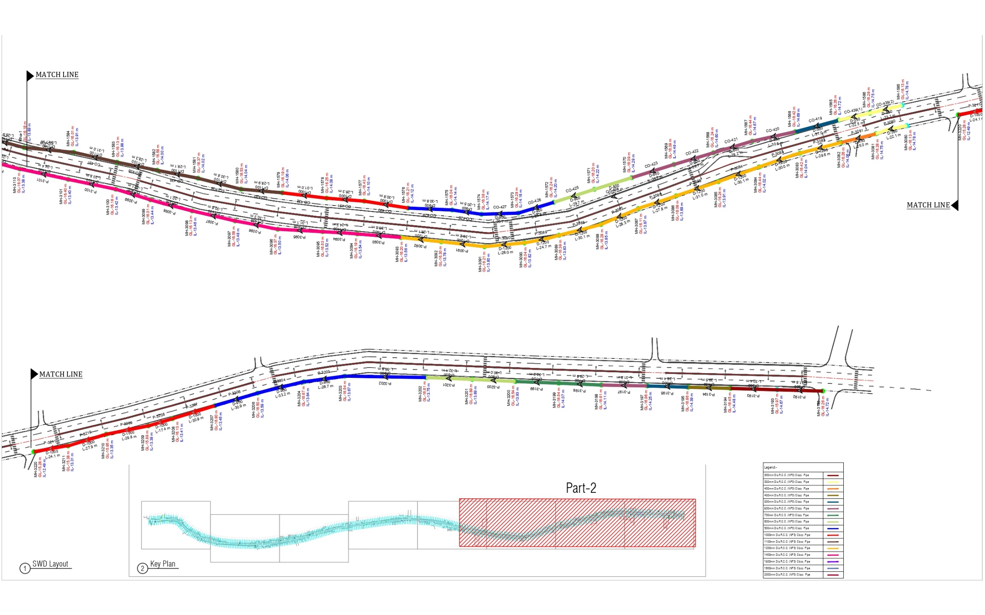
Storm Water Drain Layout

Slide 9
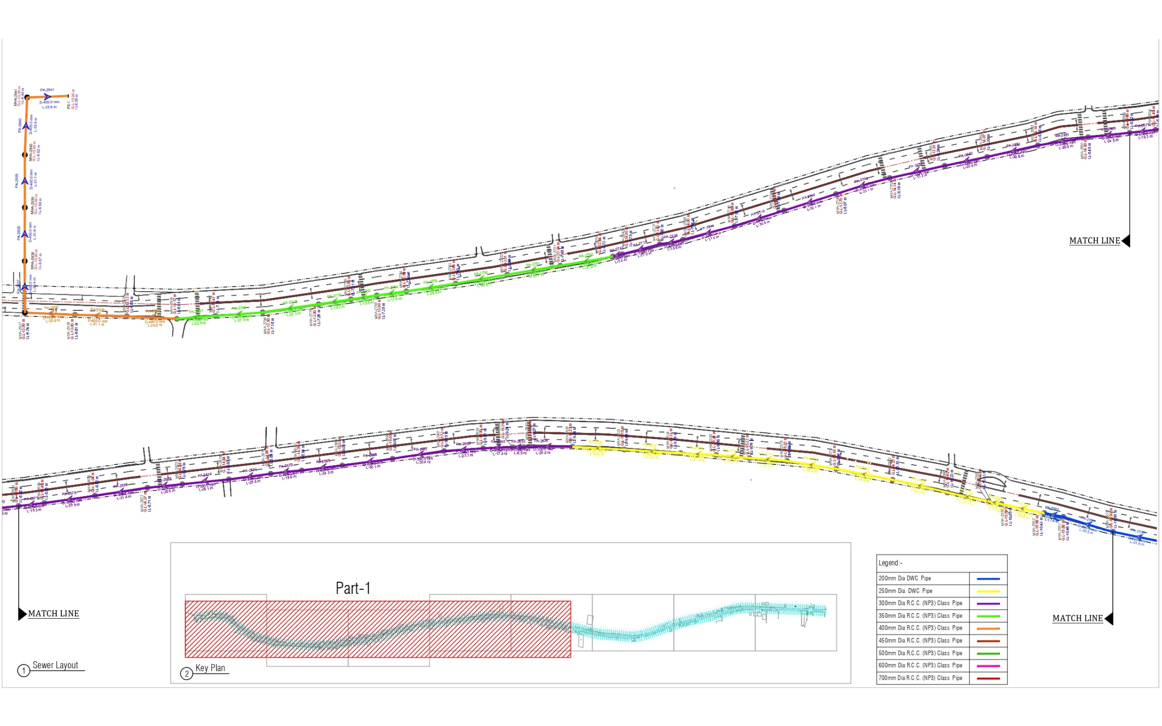
Sewer Layout

Slide 10
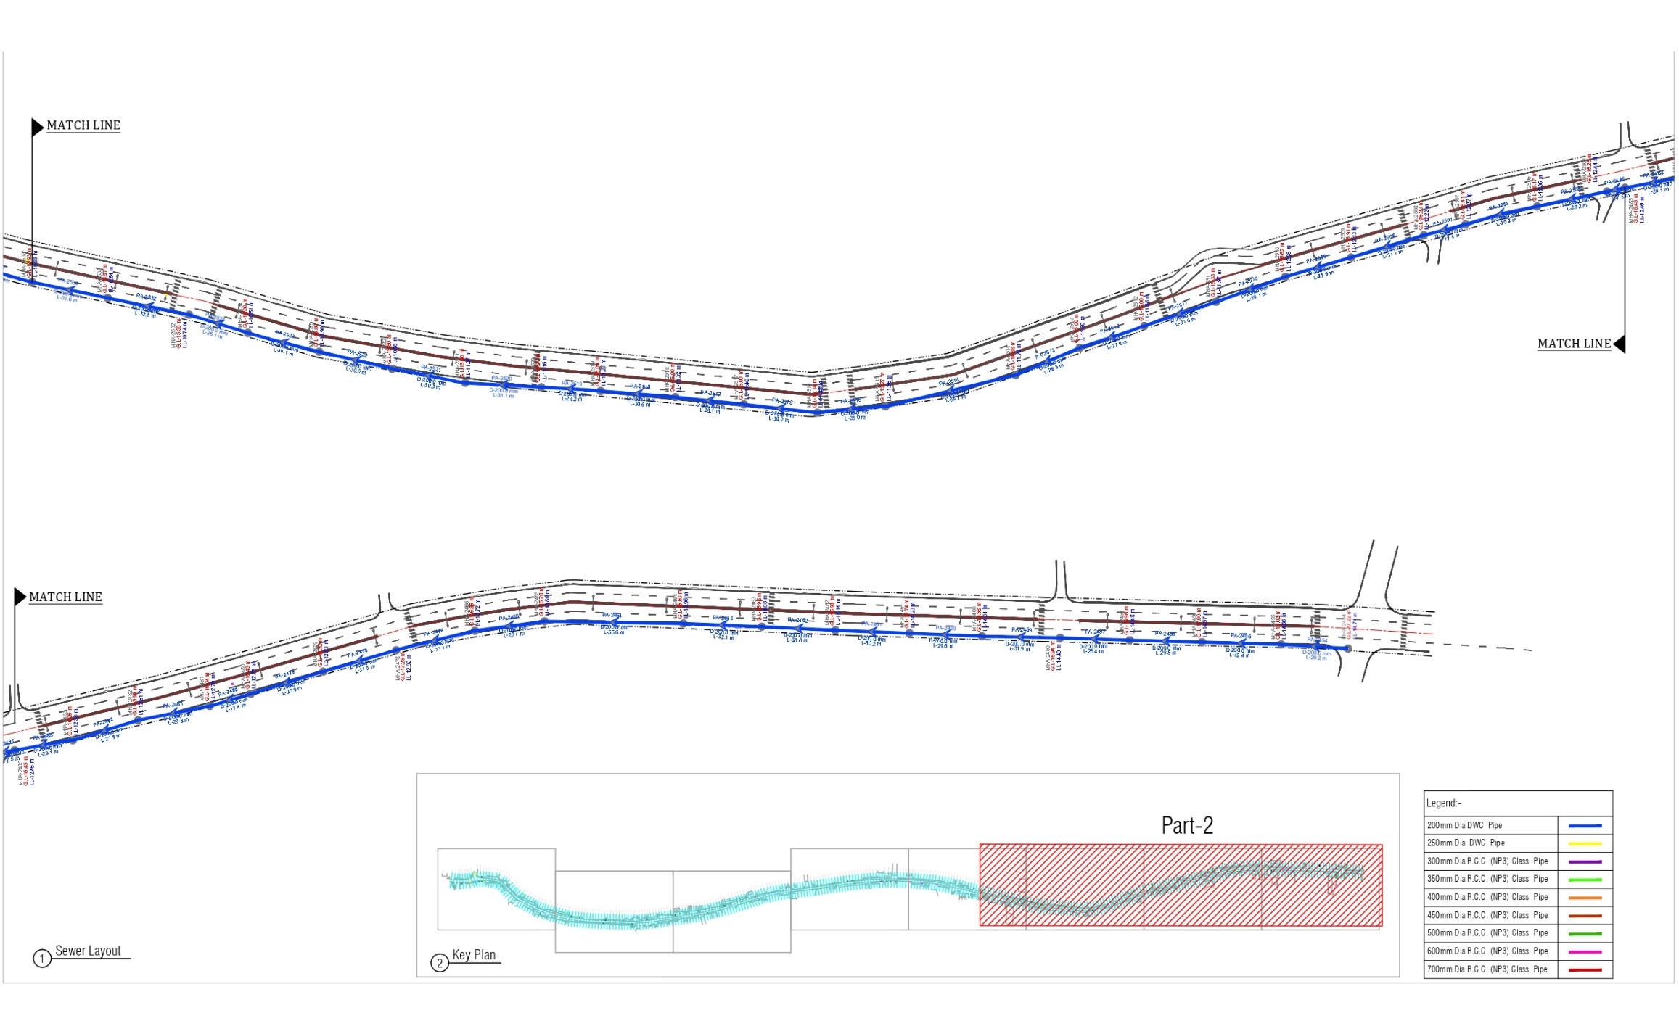
Sewer Layout

Slide 11
Cost Summary Summary
SR. NO. | DESCRIPTION OF WORK | TOTAL AMOUNT IN RS.
1 | SEWER | 2,25,49,848.00
2 | STORM | 7,28,06,648.00
 | TOTAL AMOUNT | 9,53,56,496.00

Slide 12
Thank You

