Slide 1
NAVSARI-VIJALPORE NAGARPALIKA
PAY & USE

Slide 2


Slide 3

Pay & Use
Name and Location
01 Junathan Navsari
02 Vegitable Market
03 Railway Station
04 Madhumati Market
05 Surya nagar Vijalpore

Slide 4
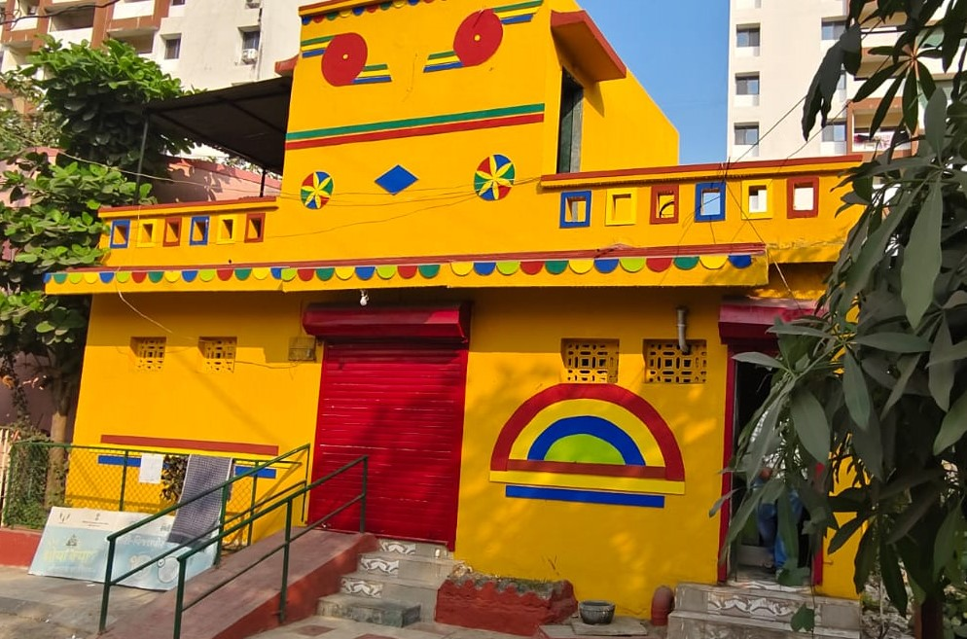
01 Junathan pay and Use
1) MALE TOILE UNIT -4
2) FIMALE TOILET -3
3) PWD TOILT -1
4) CHILD TOILET -1
5) BATH -1
6) WASH BASINE -3
7) URINAL-6
8) MIRROR -2
9) RAMP
10) PLUMBING / WATER DRAINCONNECTION
11) WATER TANK – U.G TANK
12) LIGHTE
13) EXOSTING FAN
14) FLORRING WORK
15) DOOR & VENTILATION
16) COLOUR & PAINTING

Slide 5
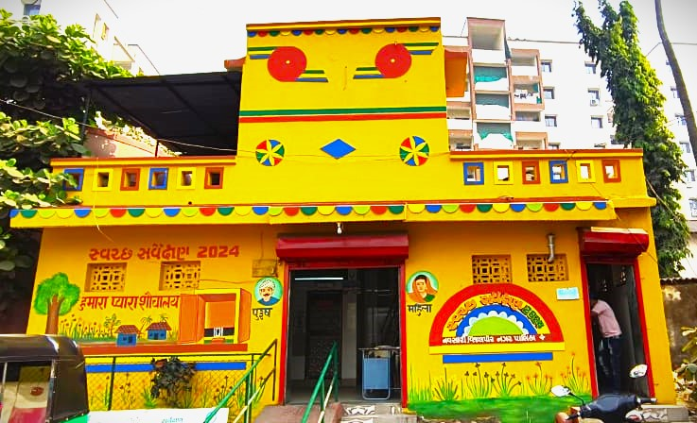
01 Junathan
pay and Use

Slide 6
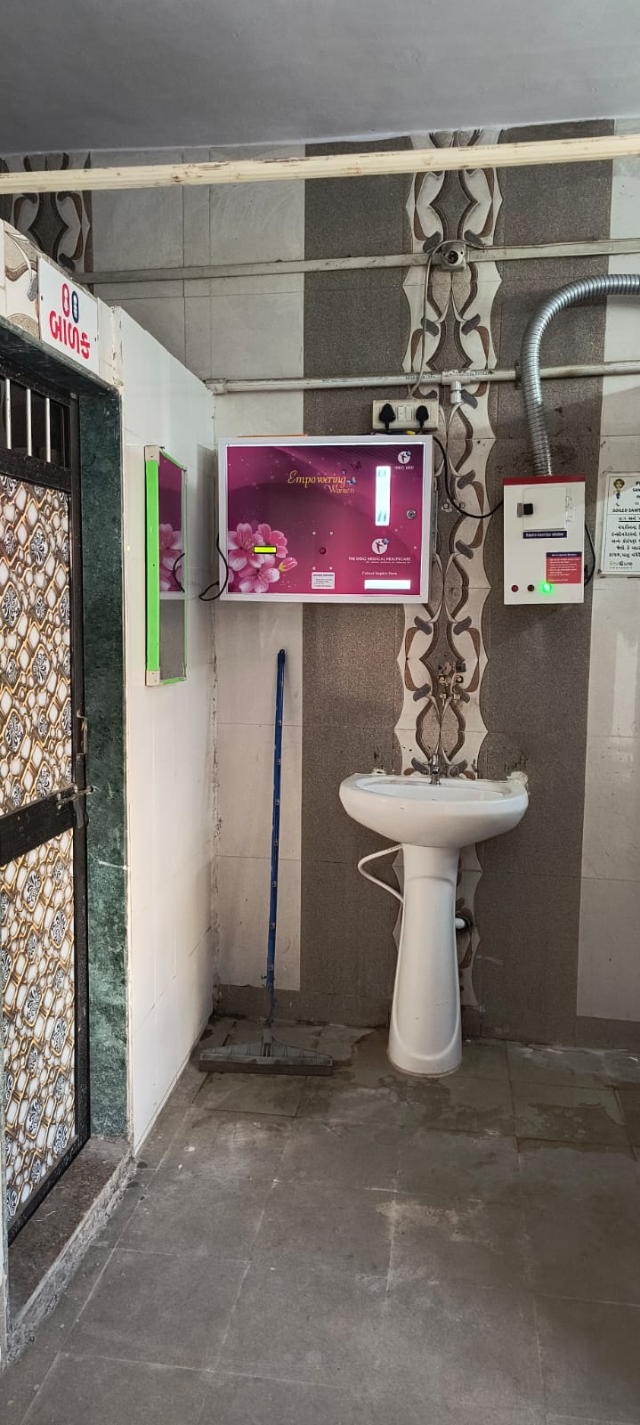
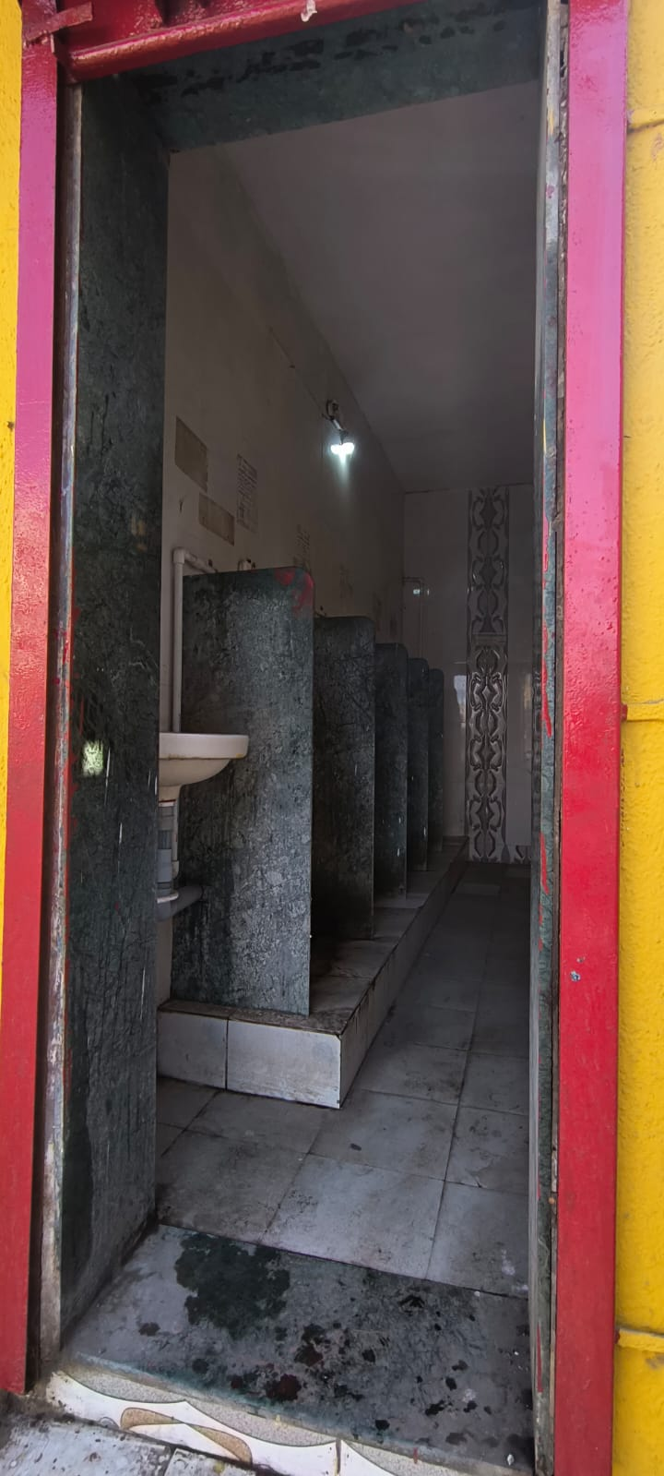
01 Junathan
pay and Use

Slide 7
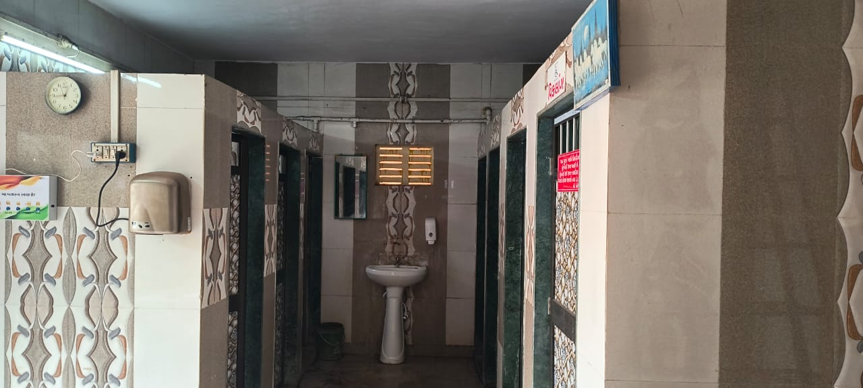

Slide 8
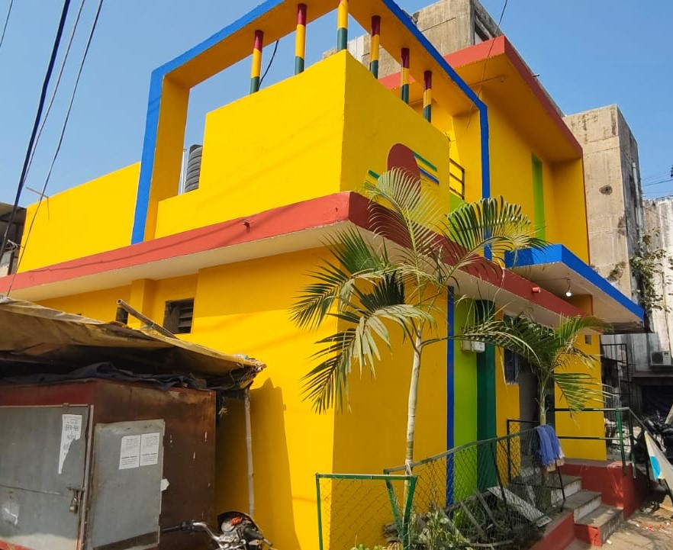
02 Vegitable Market pay and Use
1) MALE TOILE UNIT - 6
2) FIMALE TOILET -5
3) PWD TOILT -1
4) CHILD TOILET -1
5) BATH -3
6) WASH BASINE -2
7) URINAL-4
8) MIRROR -2
9) RAMP
10) PLUMBING / WATER DRAINCONNECTION
11) WATER TANK – U.G TANK
12) LIGHTE
13) EXOSTING FAN
14) FLORRING WORK
15) DOOR & VENTILATION
16) COLOUR & PAINTING

Slide 9
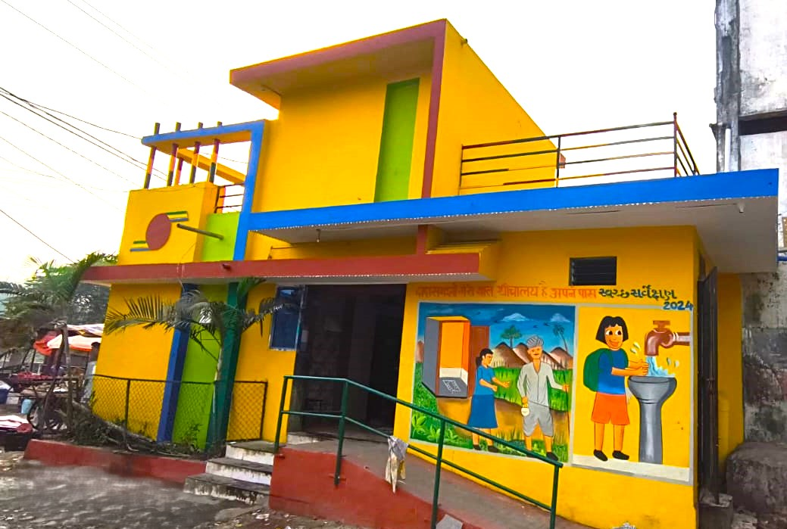
02 Vegitable Market
pay and Use

Slide 10
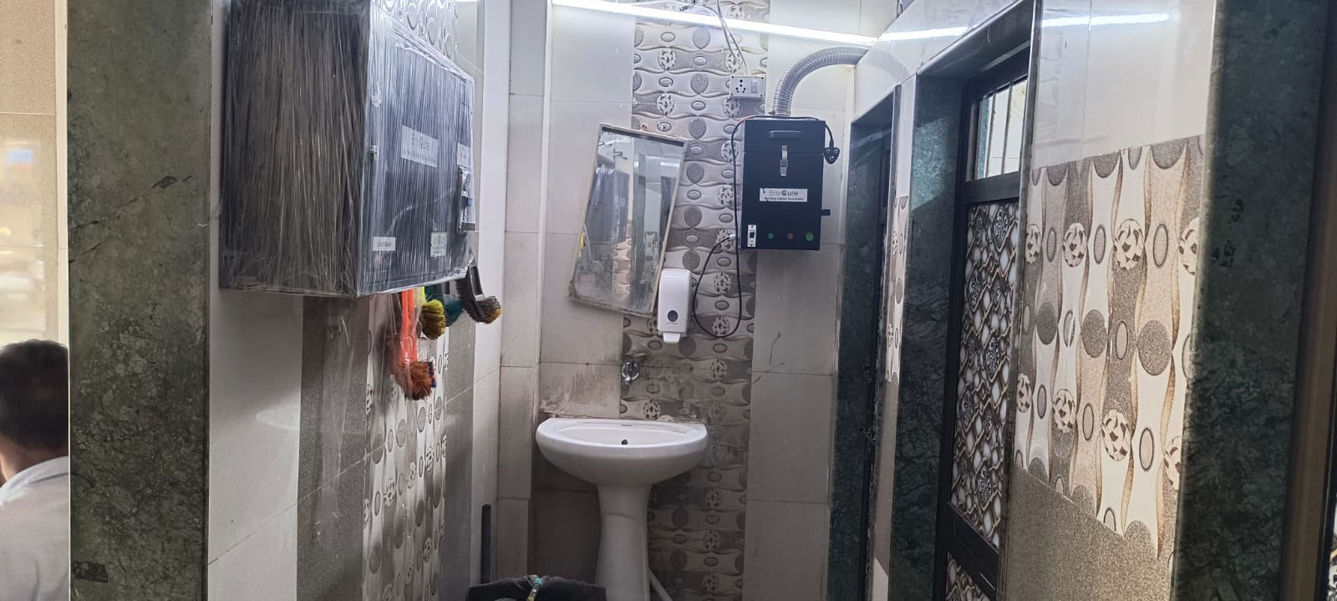
02 Vegitable Market
pay and Use

Slide 11
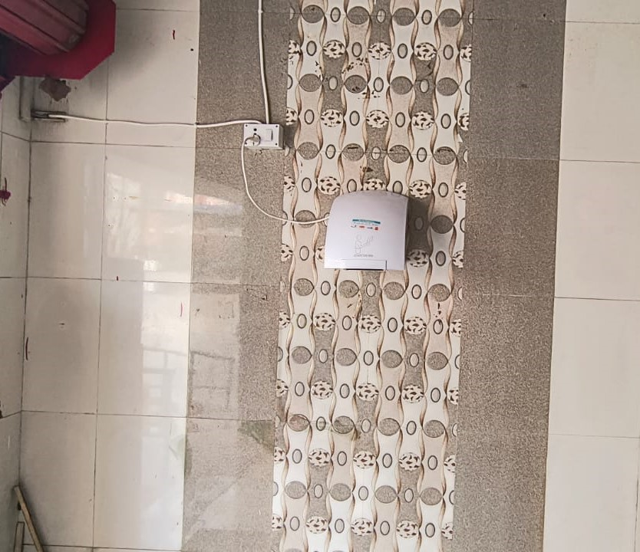
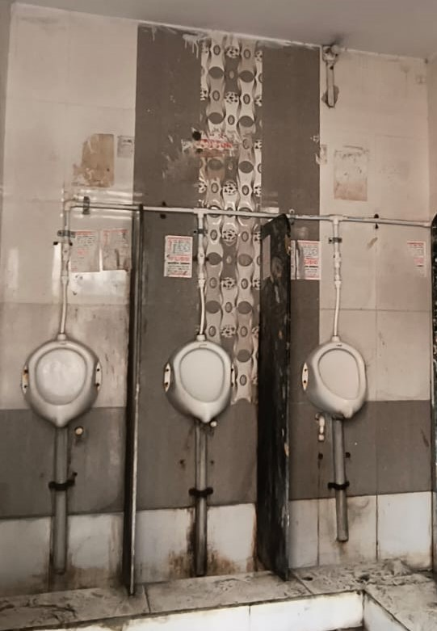
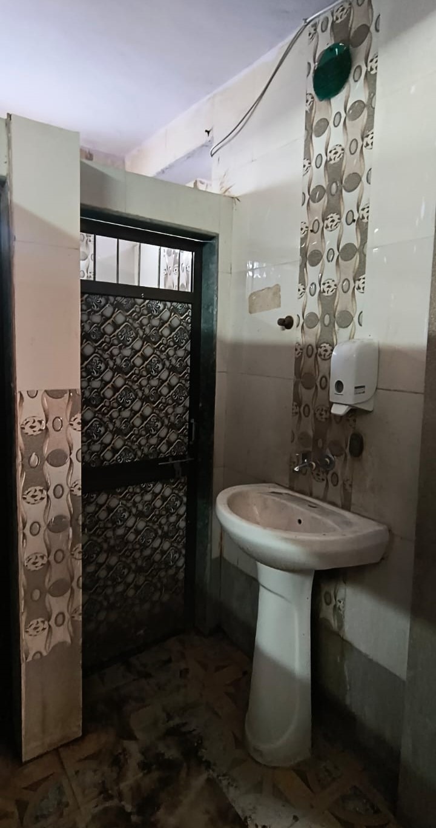
02 Vegitable Market
pay and Use

Slide 12
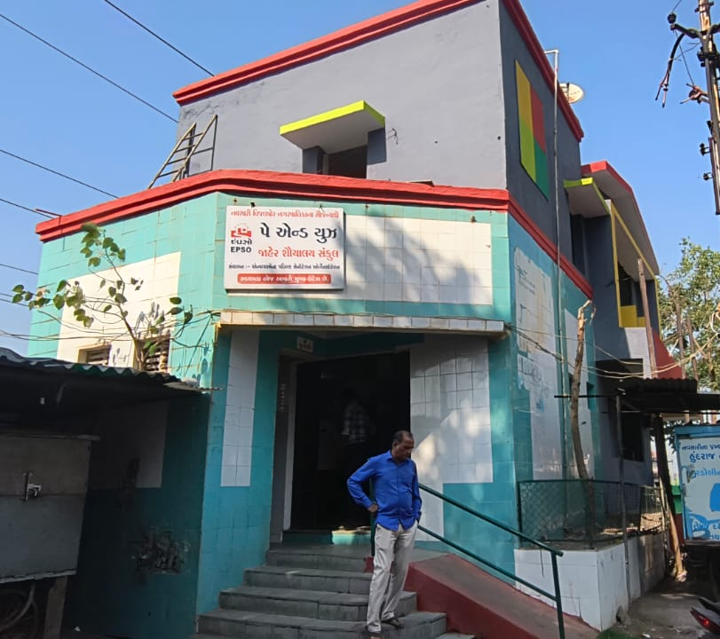
03 Railway Station pay and Use
1) MALE TOILE UNIT -5
2) FIMALE TOILET -3
3) PWD TOILT -1
4) CHILD TOILET -1
5) BATH -4
6) WASH BASINE -1
7) URINAL-4
8) MIRROR -1
9) RAMP
10) PLUMBING / WATER DRAINCONNECTION
11) WATER TANK – U.G TANK
12) LIGHTE
13) EXOSTING FAN
14) FLORRING WORK
15) DOOR & VENTILATION
16) COLOUR

Slide 13
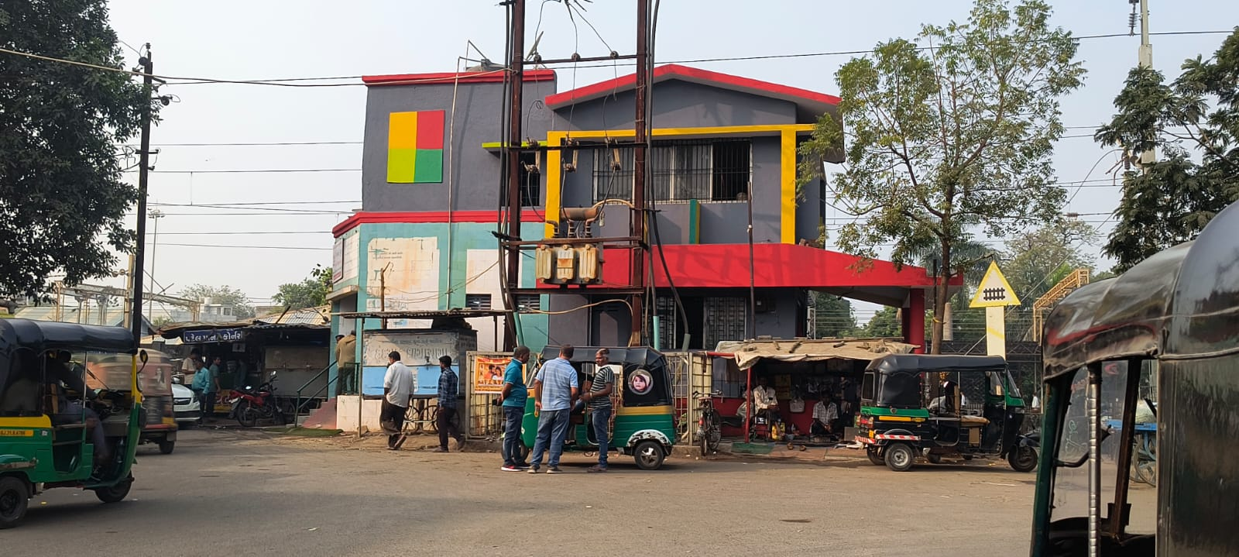
03 Railway Station
pay and Use

Slide 14
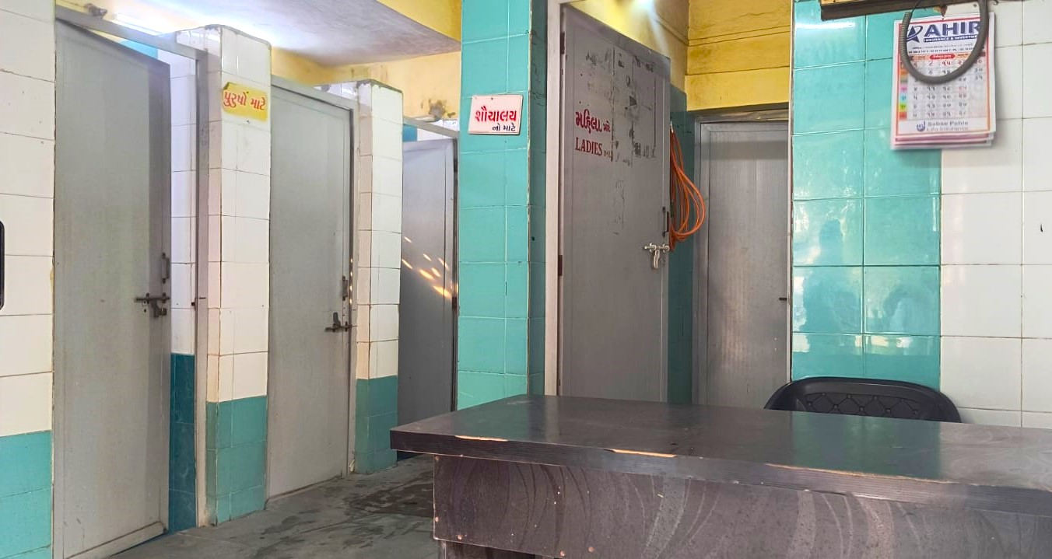
03 Railway Station
pay and Use

Slide 15
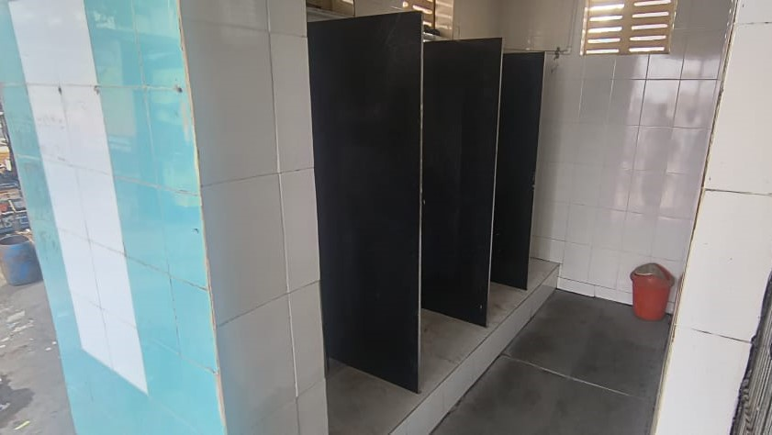
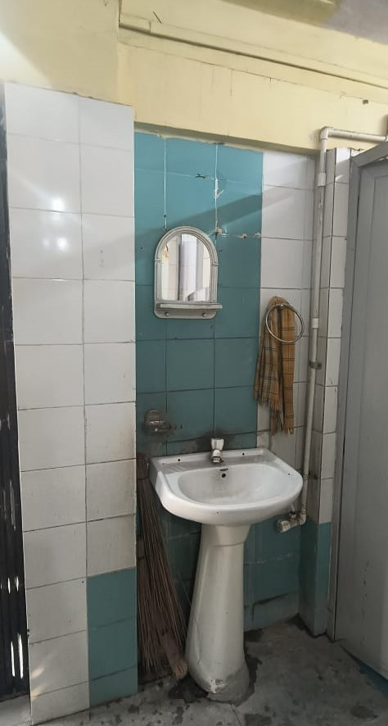
03 Railway Station
pay and Use

Slide 16
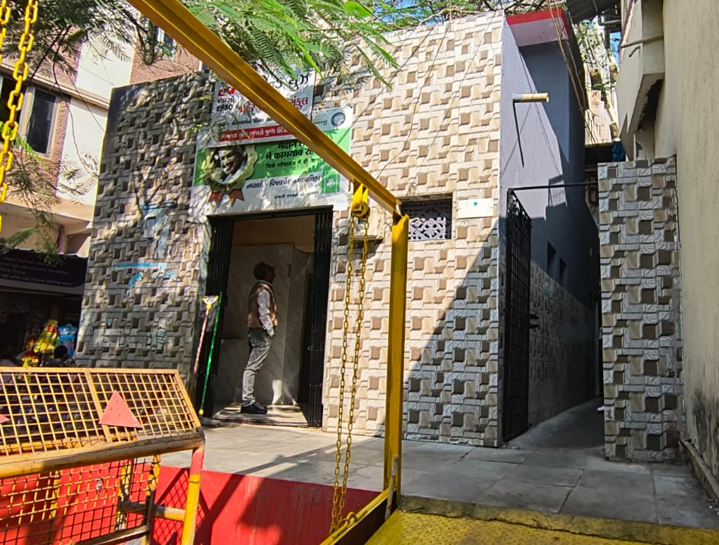
04 Madhumati Market pay and Use
1) MALE TOILE UNIT -4
2) FIMALE TOILET -2
3) PWD TOILT -1
4) CHILD TOILET -1
5) BATH -1
6) WASH BASINE -2
7) URINAL-5
8) MIRROR -1
9) RAMP
10) PLUMBING / WATER DRAINCONNECTION
11) WATER TANK – U.G TANK
12) LIGHTE
13) EXOSTING FAN
14) FLORRING WORK
15) DOOR & VENTILATION
16) COLOUR

Slide 17
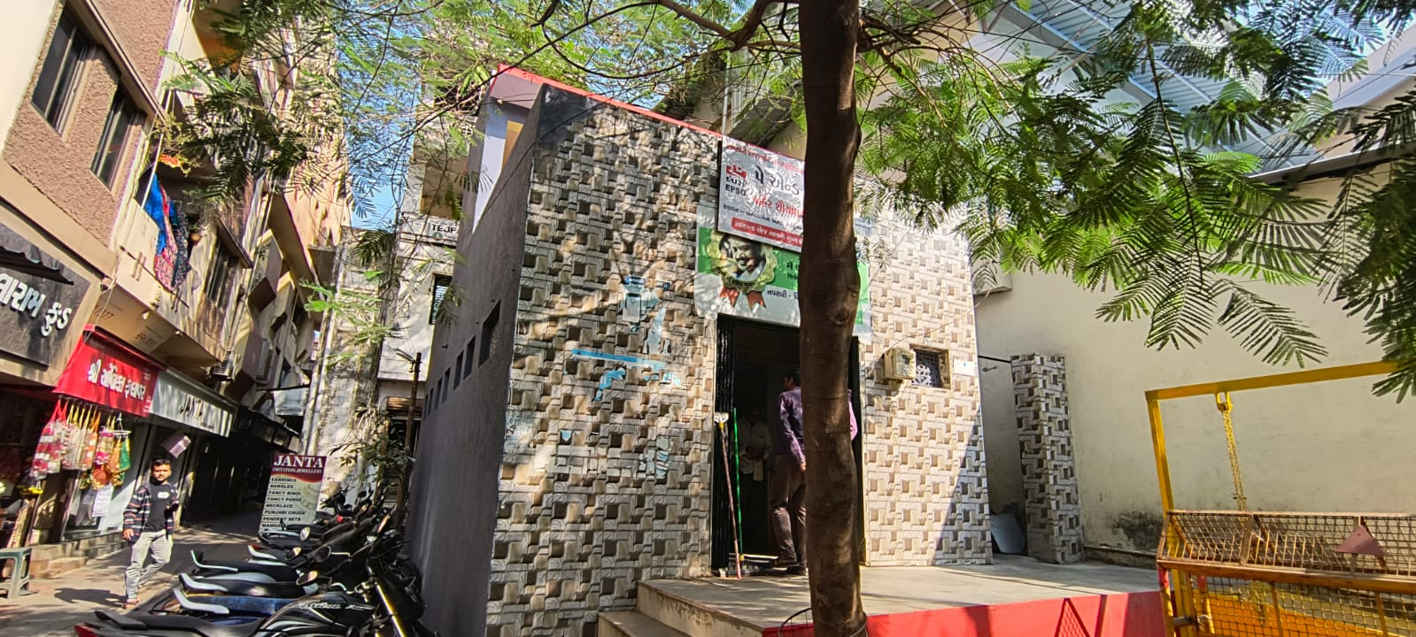
04 Madhumati Market
pay and Use

Slide 18
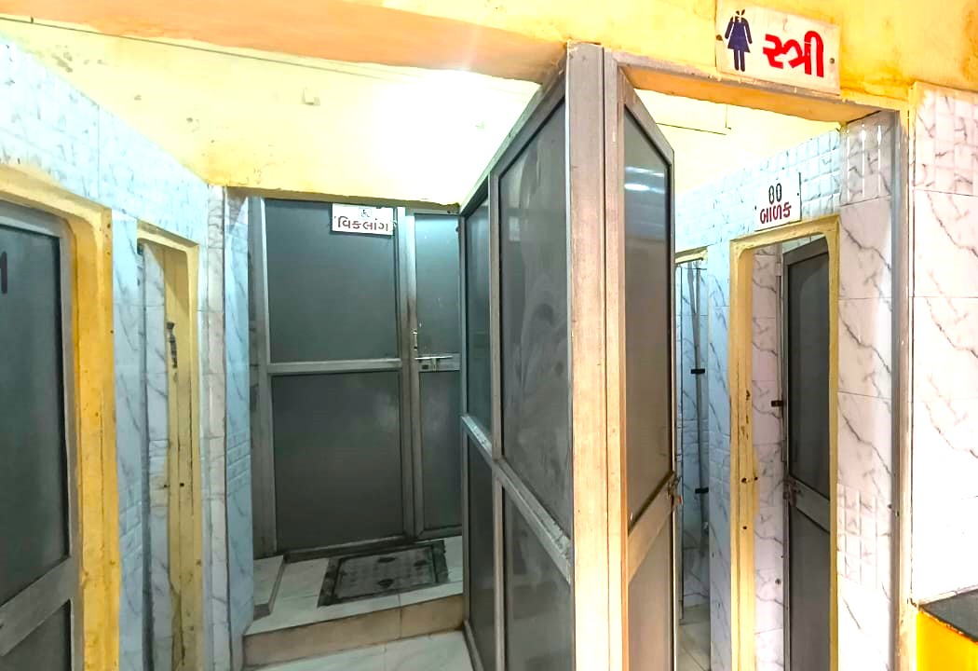
04 Madhumati Market
pay and Use

Slide 19
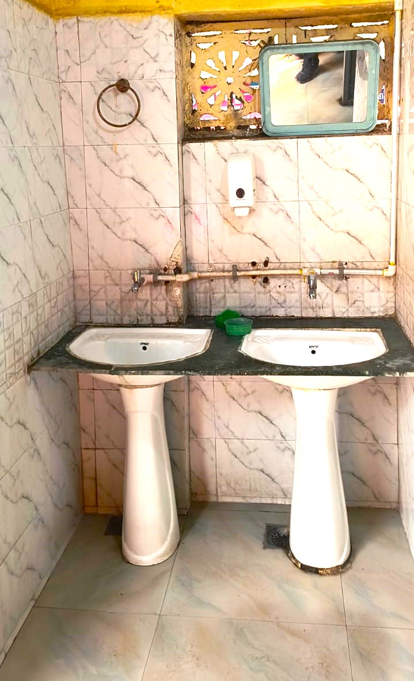
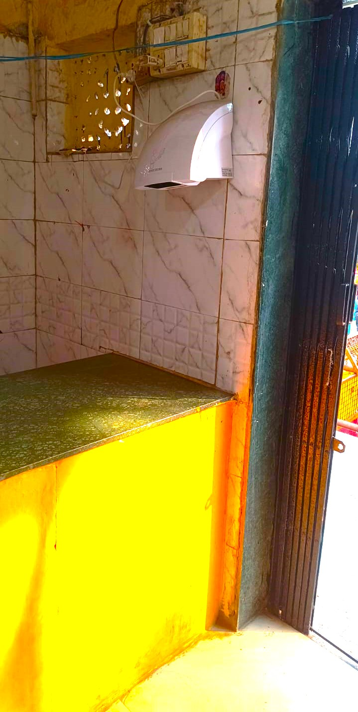
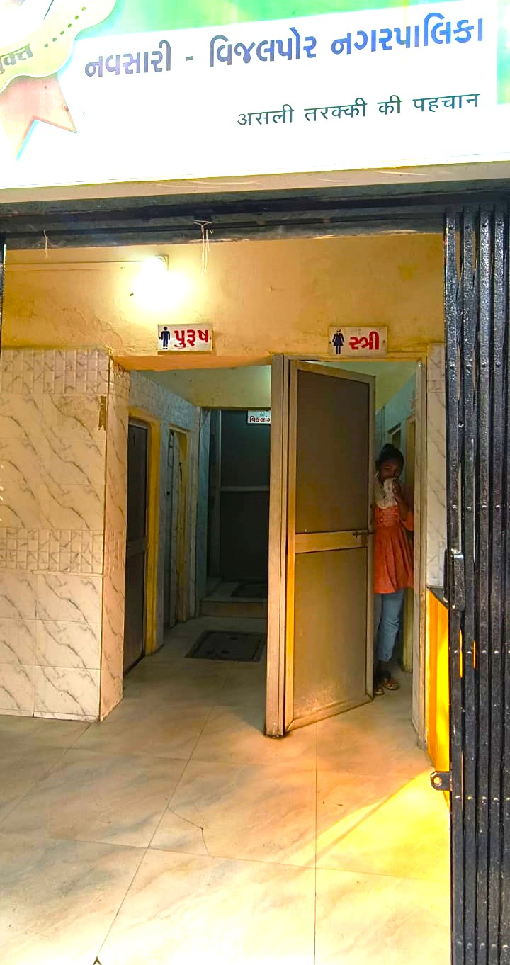
04 Madhumati Market
pay and Use

Slide 20
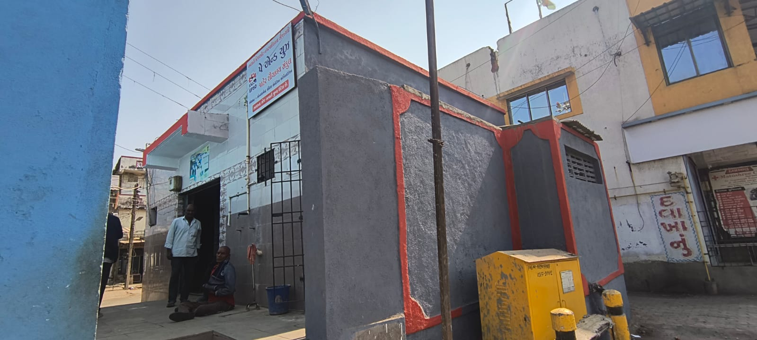
05 Surya nagar pay and Use
1) MALE TOILE UNIT -5
2) FIMALE TOILET -4
3) PWD TOILT -1
4) CHILD TOILET -1
5) BATH -2
6) WASH BASINE -1
7) URINAL-6
8) MIRROR -1
9) RAMP
10) PLUMBING / WATER DRAINCONNECTION
11) WATER TANK – U.G TANK
12) LIGHTE
13) EXOSTING FAN
14) FLORRING WORK
15) DOOR & VENTILATION
16) COLOUR

Slide 21
Thank You
Navsari Vijalpore nagarpalika

